Slide 1
Optical Trackers
Vincenzo Ferrari
Dipartimento Ingegneria dell’Informazione - Università di Pisa

Slide 2
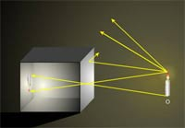
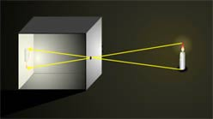
Pinhole camera

Slide 3
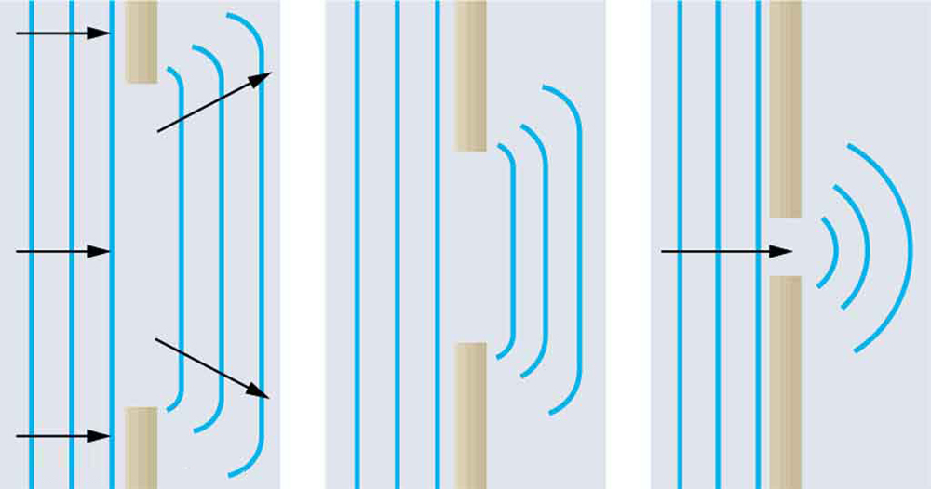
Approximation of the light with rays
Dimensions >> light wavelenght → geometric opctics approx OK!
Visible light wavelenght 700 nm – 400 nm

Slide 4
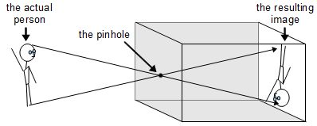
Pinhole camera

Slide 5
Pinhole camera

Slide 6
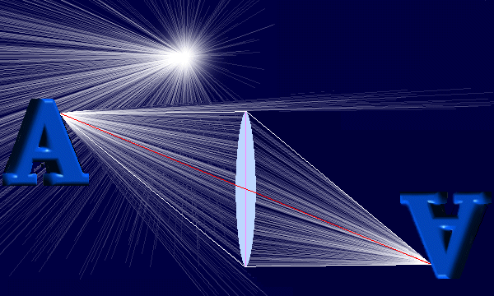
We need a lens

Slide 7
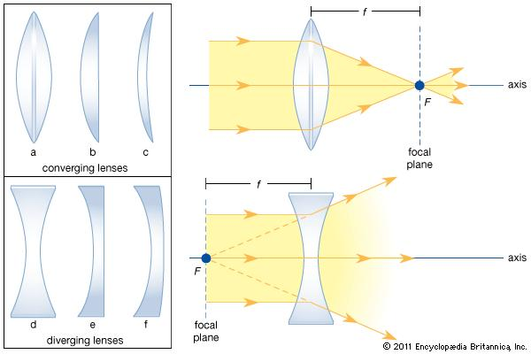
We need a lens

Slide 8
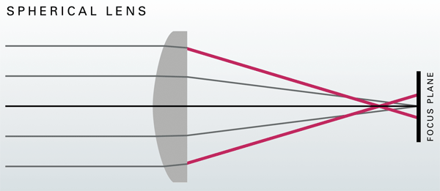
How a spherical lens work

Slide 9
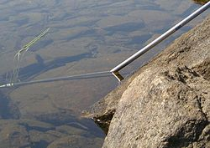
Refraction

Slide 10
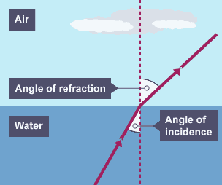
Refraction

Slide 11
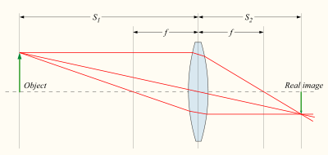
Spherical lenses approximation

Slide 12
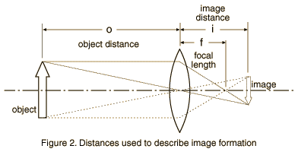
Pinhole approximation
CP

Slide 13
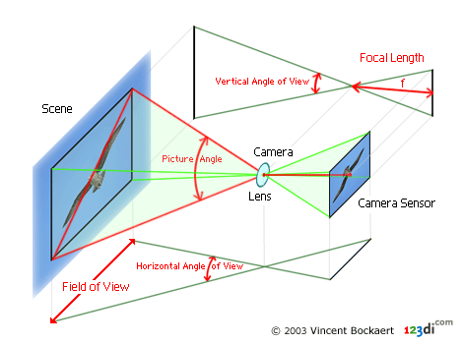
Pinhole camera model
CP

Slide 14
Pinhole camera model
CP

Slide 15
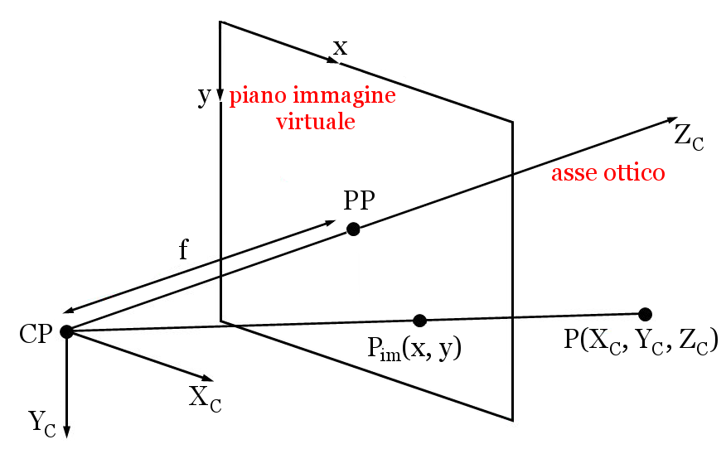
(Xpp,Ypp)
3D point
2Dpoint

Slide 16
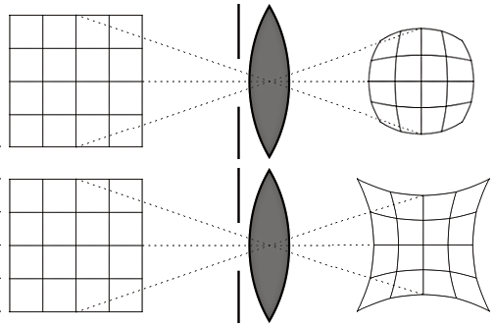
Lens distortion compensation

Slide 17
(Xpp,Ypp)
3D point
2Dpoint

Slide 18
Pixelizzation

Slide 19
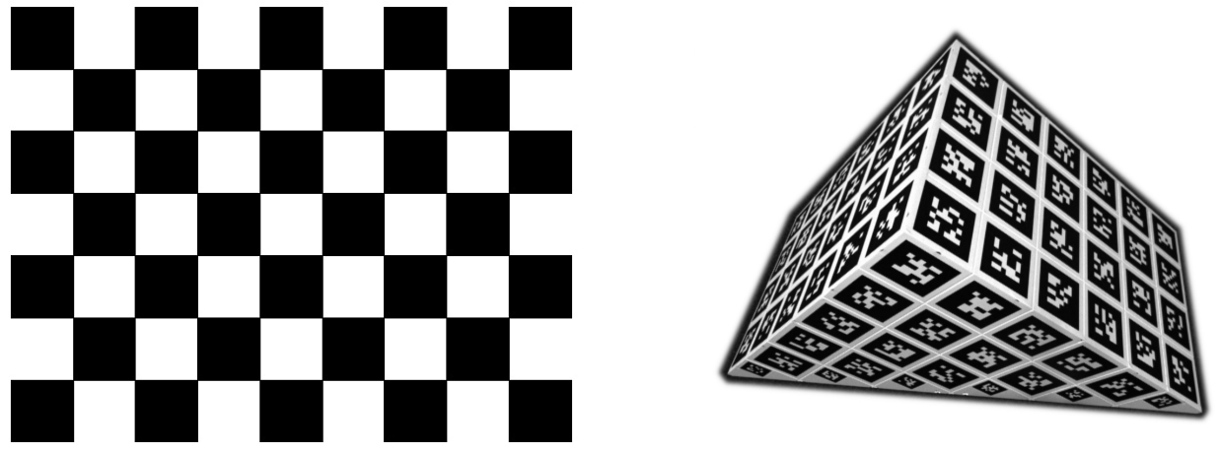
Camera calibration: intrinsic parameters
OpenCV, Matlab (Computer Vision Toobox)
Zhang’s method
Lens distortion model
Center of projection
Focal lenght
….

Slide 20
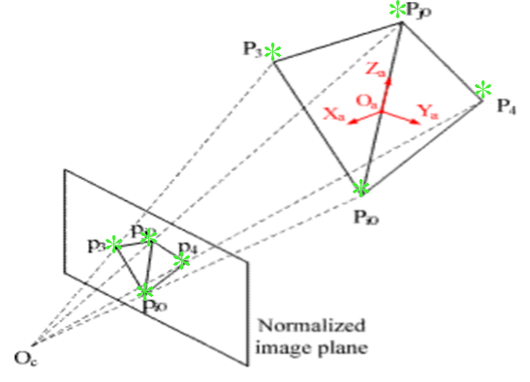
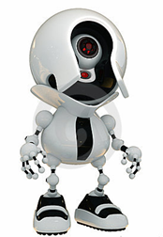
Monoscopic localization of objects
PnP problem
-3 points: unique solution not guaranteed
-4 points on a plane: unique solution guaranteed
-6 points: unique solution guaranteed

Slide 21
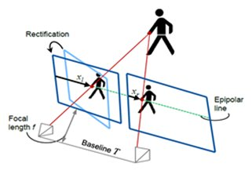
Stereo triangulation

Slide 22
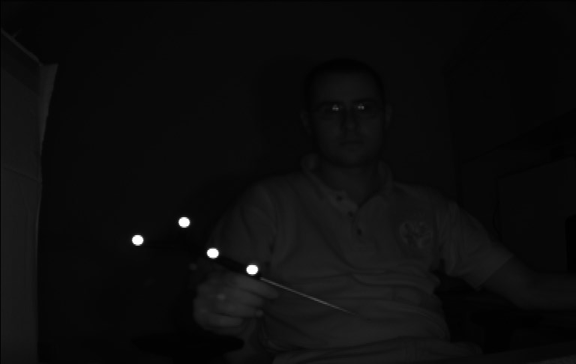
Infrared tracking systems
http://www.ndigital.com/

Slide 23
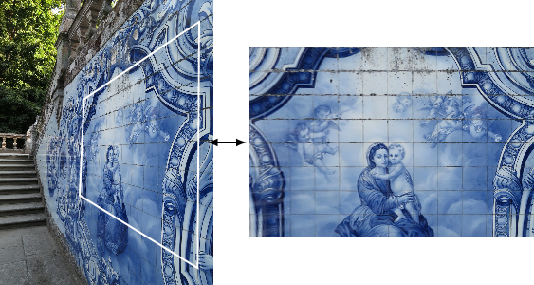
Puntualizzazione…

Slide 24
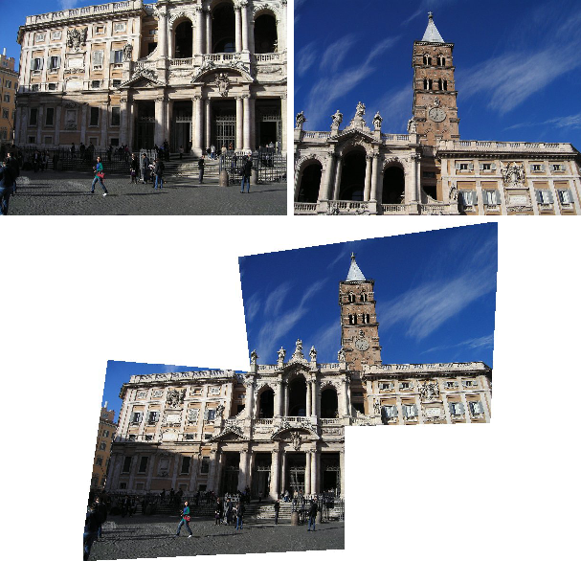

Slide 25
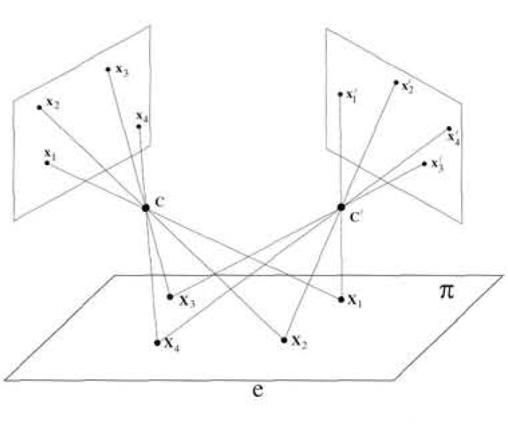
Notes:
We can mitigate the parallax issues via software using a simple homographyc function that, knowing the typical working distance, allows to determine the trasformation between a point acquired by the camera to the display preserving the perspective on the homographyc plane

Slide 26
ESERCIZI
Definire una trasformazione a partire dalla conoscenza di 3 punti
Definire un sistema di riferimento note le matrici di trasformazione di 2 sensori a 5dof

