Slide 1
Optical Trackers
Vincenzo Ferrari
Dipartimento Ingegneria dell’Informazione - Università di Pisa

Slide 2
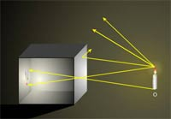
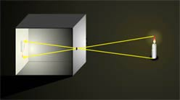
Pinhole camera

Slide 3
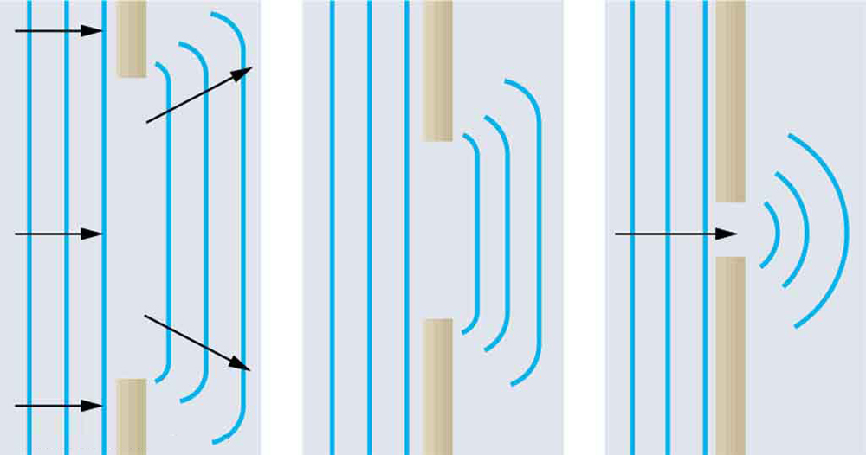
Approximation of the light with rays
Dimensions >> light wavelenght → geometric opctics approx OK!
Visible light wavelenght 700 nm – 400 nm

Slide 4
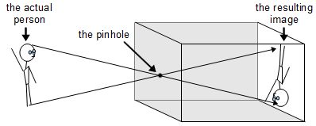
Pinhole camera

Slide 5
Pinhole camera

Slide 6
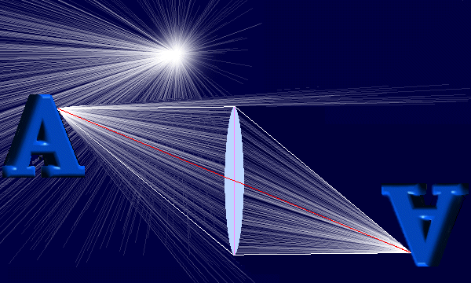
We need a lens

Slide 7
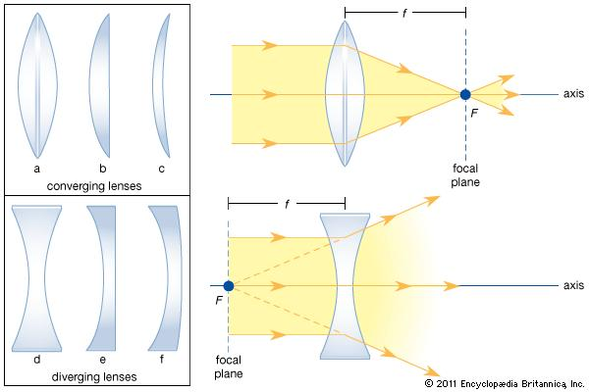
We need a lens

Slide 8
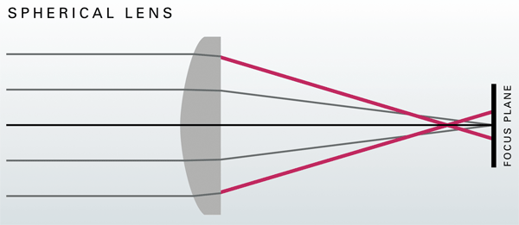
How a spherical lens work

Slide 9
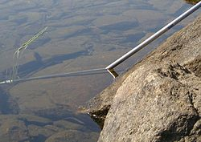
Refraction

Slide 10
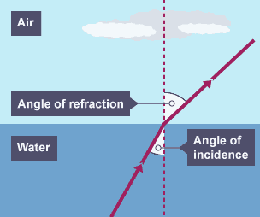
Refraction

Slide 11
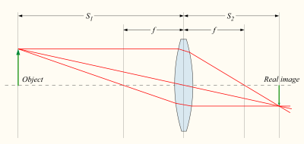
Spherical lenses approximation

Slide 12
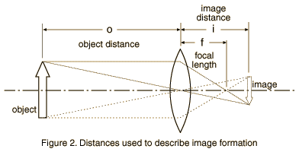
Pinhole approximation
CP

Slide 13
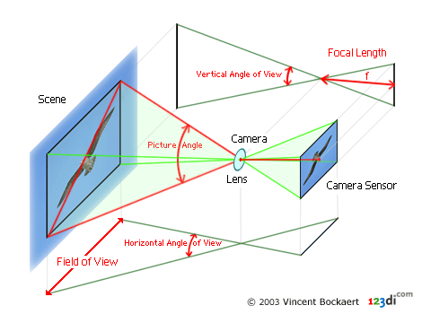
Pinhole camera model
CP

Slide 14
Pinhole camera model
CP

Slide 15
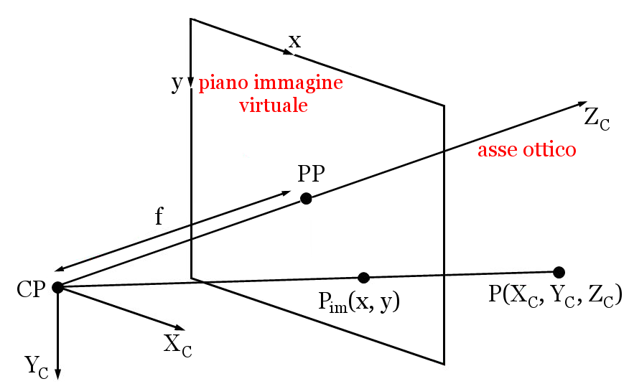
(Xpp,Ypp)
3D point
2Dpoint

Slide 16
(Xpp,Ypp)
3D point
2Dpoint
$$\left[\begin{matrix}x \\ y \\ 1\end{matrix}\right]=\frac{1}{Z_{C}}\left[\begin{matrix}f & 0 & x_{PP} \\ 0 & f & y_{PP} \\ 0 & 0 & 1\end{matrix}\right]⋅\left[\begin{matrix}X_{C} \\ Y_{C} \\ Z_{C}\end{matrix}\right]$$
$$\left[\begin{matrix}x \\ y \\ 1\end{matrix}\right]\sim \left[\begin{matrix}f & 0 & x_{PP} \\ 0 & f & y_{PP} \\ 0 & 0 & 1\end{matrix}\right]⋅\left[\begin{matrix}X_{C} \\ Y_{C} \\ Z_{C}\end{matrix}\right]$$

Slide 17
Pixelizzation: from mm to pixels
$$\left[\begin{matrix}x \\ y \\ 1\end{matrix}\right]\sim \left[\begin{matrix}f & 0 & x_{PP} \\ 0 & f & y_{PP} \\ 0 & 0 & 1\end{matrix}\right]⋅\left[\begin{matrix}X_{C} \\ Y_{C} \\ Z_{C}\end{matrix}\right]$$
Matrice di proiezione con dimensioni fisiche
$$\left[\begin{matrix}u \\ v \\ 1\end{matrix}\right]=\left[\begin{matrix}x/s_{x} \\ y/s_{y} \\ 1\end{matrix}\right]\sim \left[\begin{matrix}f/s_{x} & 0 & x_{PP}/s_{x} \\ 0 & f/s_{y} & y_{PP}/s_{y} \\ 0 & 0 & 1\end{matrix}\right]⋅\left[\begin{matrix}X_{C} \\ Y_{C} \\ Z_{C}\end{matrix}\right]$$
$$\left[\begin{matrix}u \\ v \\ 1\end{matrix}\right]\sim \left[\begin{matrix}p_{x} & k & c_{x} \\ 0 & p_{y} & c_{y} \\ 0 & 0 & 1\end{matrix}\right]⋅\left[\begin{matrix}X_{C} \\ Y_{C} \\ Z_{C}\end{matrix}\right]$$
Matrice di proiezione con dimensioni in pixel
Il pixel è adimensionale, quindi torna che possa moltiplicare per un λ
$$\left[\begin{matrix}u \\ v \\ 1\end{matrix}\right]=\text{λ}\left[\begin{matrix}p_{x} & k & c_{x} \\ 0 & p_{y} & c_{y} \\ 0 & 0 & 1\end{matrix}\right]⋅\left[\begin{matrix}X_{C} \\ Y_{C} \\ Z_{C}\end{matrix}\right]$$

Slide 18
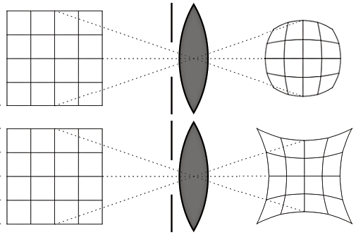
Lens distortion compensation

Slide 19
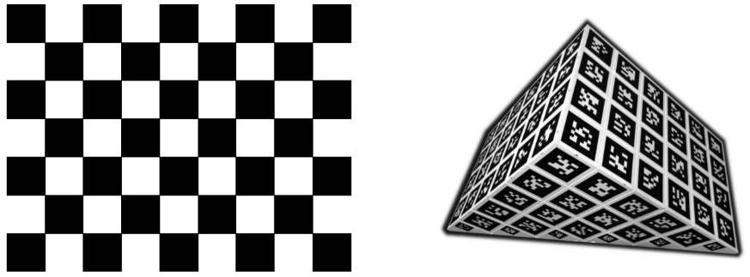
Camera calibration: intrinsic parameters
OpenCV, Matlab (Computer Vision Toobox)
Zhang’s method
Lens distortion model
Center of projection
Focal lenght
….

Slide 20
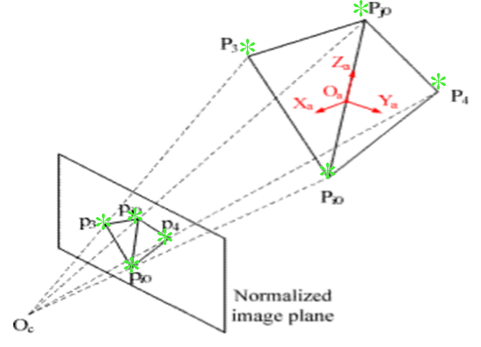
Monoscopic localization of objects
PnP problem
-3 points: unique solution not guaranteed
-4 points on a plane: unique solution guaranteed
-6 points everywhere: unique solution guaranteed

Slide 21
Esercitazione matlab

Slide 22
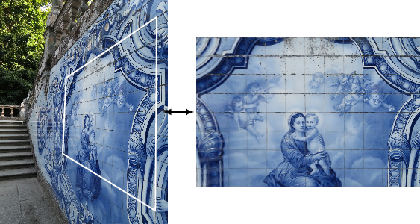
Puntualizzazione…

Slide 23
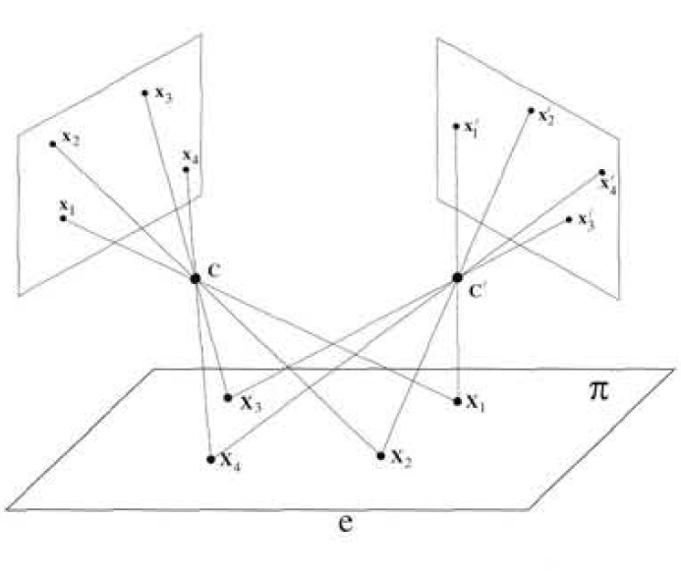
Notes:
We can mitigate the parallax issues via software using a simple homographyc function that, knowing the typical working distance, allows to determine the trasformation between a point acquired by the camera to the display preserving the perspective on the homographyc plane

Slide 24
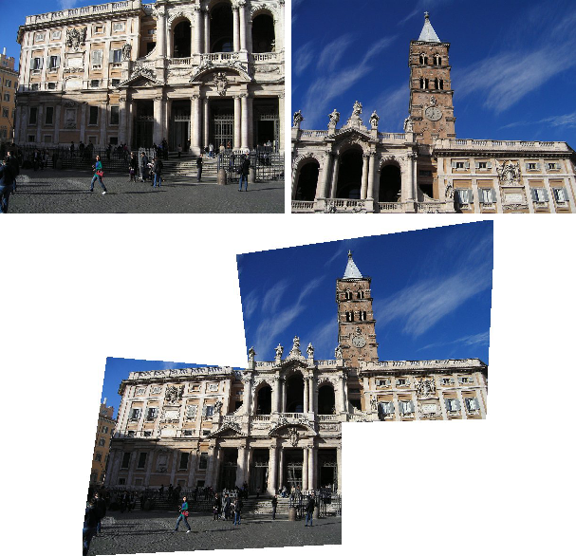

Slide 25
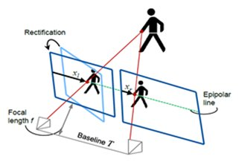
Stereo triangulation

Slide 26
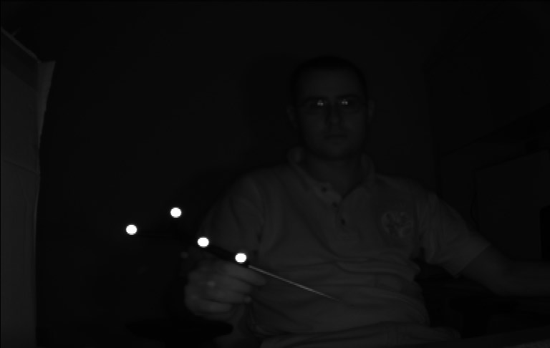
Infrared tracking systems
http://www.ndigital.com/
https://www.youtube.com/watch?v=xDxSte0eZRM

